Slide 1





G. H. RAISONI COLLEGE OF ENGINEERING
AND MANAGEMENT, P﻿UNE
An autonomous institute affiliated to Savitribai Phule Pune University (SPPU)
INTERNSHIP REVIEW - I
rego Digital Solutions Pvt Ltd

Slide 2
Department of Data Science
Name of Intern : Ms. Karina Bhanudas Chaure
Registration No: 2021DDSE1103081
Internal Mentor: Prof Nishigandha Vyawhare
External Mentor: Mr. Pratik Sable
Academic Year: 2022-2023

Slide 3

About Company
REGO is a leading software, web and mobile app development company that has been delivering a peerless set of technology services to various businesses over an eclectic domain.
We have expertise in developing modern and feature-rich mobile apps. We utilize advanced tools and technologies to build interactive mobile apps and also comprehensive approach to managing strong cloud systems that incorporates cutting-edge technology like cognitive computing and hybrid cloud models also offer the best eCommerce development services to enhance the value of your company, produce high revenue, and increase conversions.

Slide 4
Company Introduction
Name of the Company | Rego digital sol PVT LTD
Address | Nirzer Society, Gulwani Maharaj Path, Near Rahi Cafe, Kothrud, Pune 41103
Turn Over | 3.5 cr
Number of plants in India | 1
Head Office | Pune,India
Number of Emolyees | 3,500 (In India)
Name of the HR | Abhijeet Salgar ()
Contact no | 8208489126

Slide 5
WEEKLY OVERVIEW OF INTERNSHIP ACTIVITIES
1st week
Induction Program
Project Environment Setup
Knowldge Transfer Abot Project from Team Lead

Slide 6
NAME OF THE TOPIC/MODULE COMPLETED
1) Frontend Technologies:
HTML
CSS
BootStrap
React

Slide 7

Project Assigned
Project- Dento ( Medical Domain
I had the privilege of contributing to innovative project that aimed to disrupt traditional industries using cutting-edge technology.The first project "Dento", is a Web-based social media platform that provides users with an alternative services like Teeth Whitening , Missing Teeth, Cosmetic Dentistry , Examination , Teeth Pain .
As a leading industry innovator, Dento is opening up exciting new opportunities for dental professionals, investors,employees & suppliers.
I was involved in every aspect of the Frnot end development process, from conceptualization to deployment. In addition to developing code, I documented my work and participated in code reviews to ensure high-quality code and efficient processes.

Slide 8
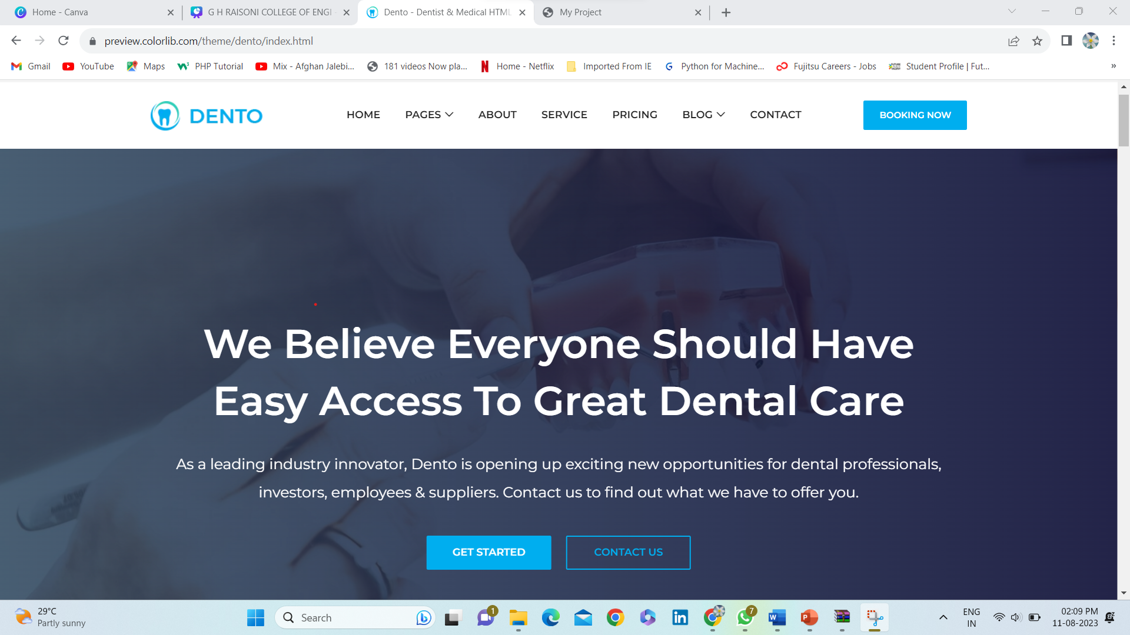

Slide 9
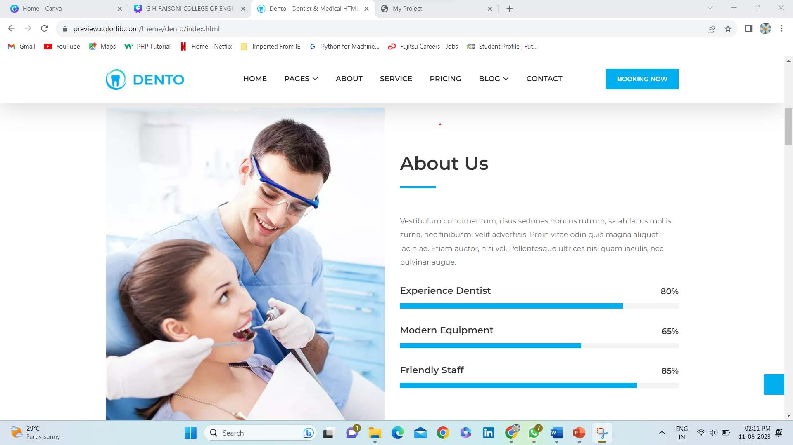

Slide 10
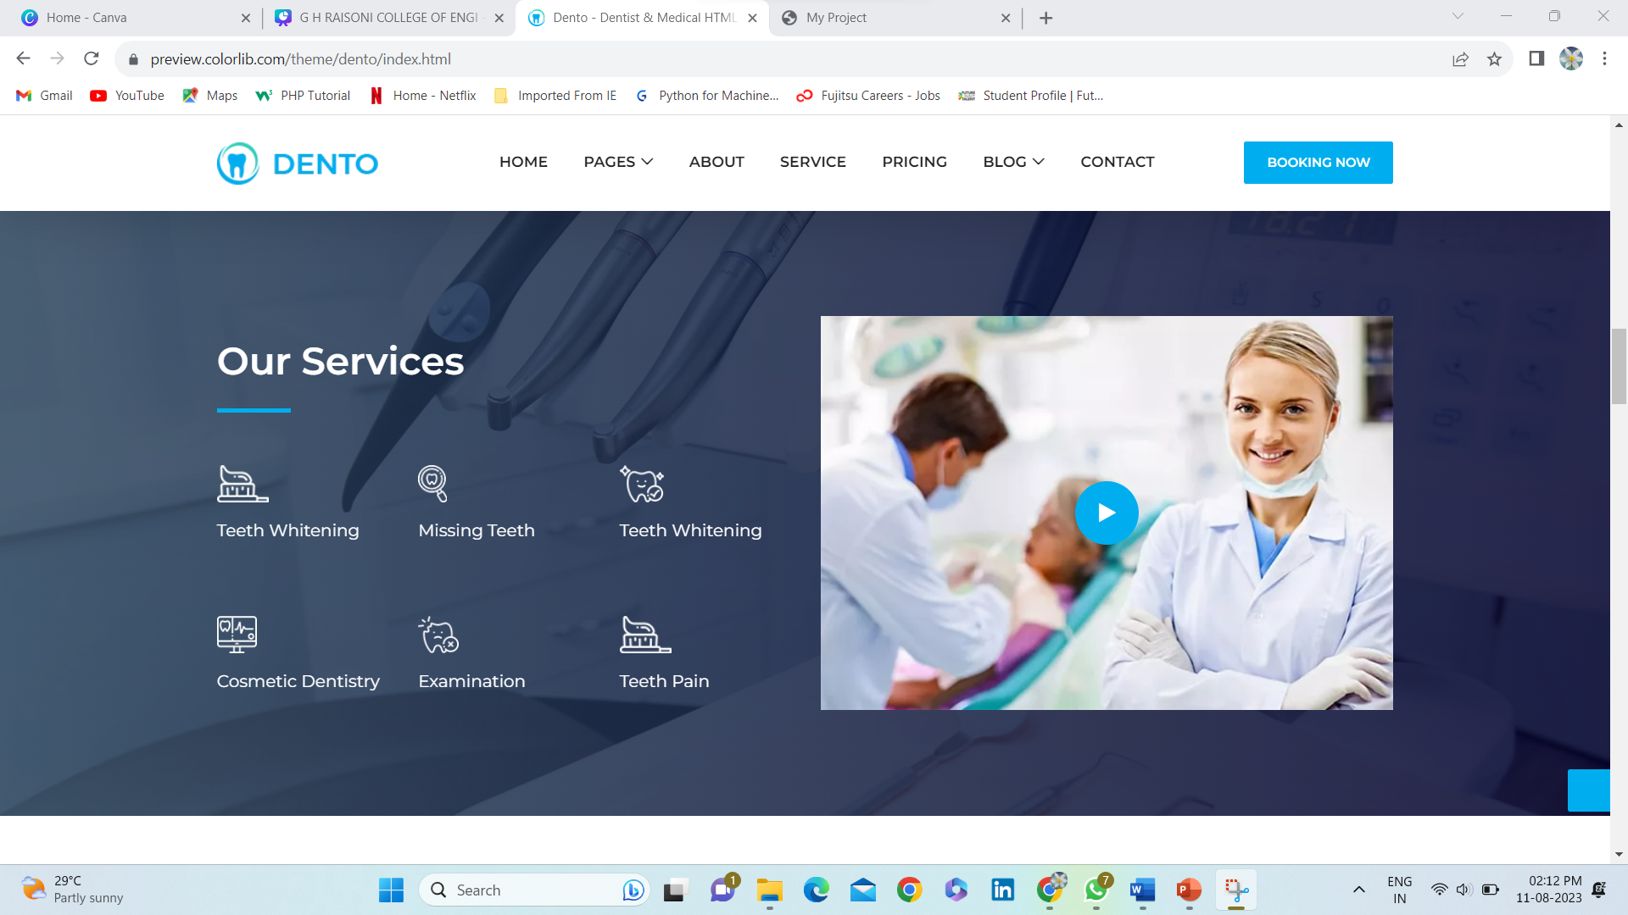

Slide 11
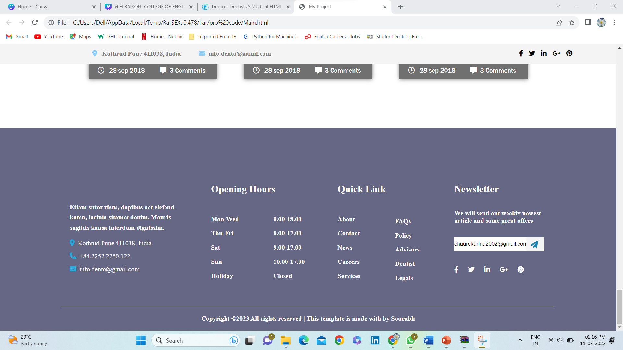

Slide 12
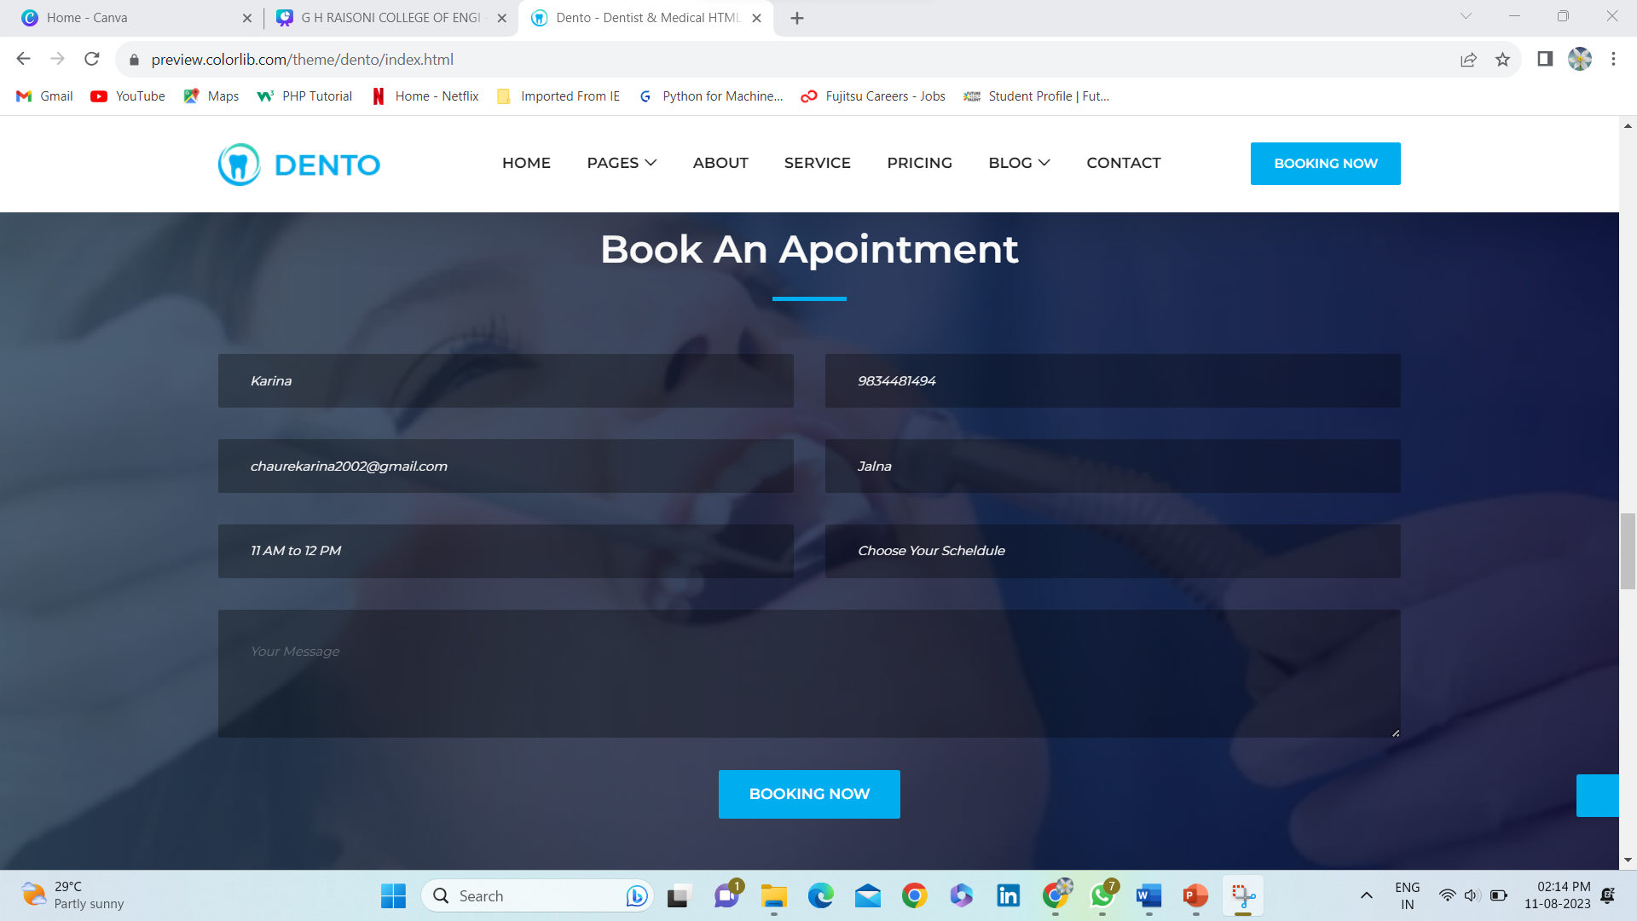

Slide 13
Thank You!

